Slide 1
Considerations when choosing priors
Priors in Bayesian Phylogenetics
Nicola F. Müller
e-mail: nicola.felix.mueller@gmail.com

Slide 2
Priors denote our prior belief/expectations in certain parameter values
Tree Prior describes how a tree was formed by a population model
Prior belief of what the parameters should be
Posterior probability
Tree likelihood
Du Plessis et al., 2015, Trends M.

Slide 3
Practical example: Choosing priors on the evolutionary rates for SARS-CoV-2
What are related viruses (preferably in the same host)
SARS
MERS
What are their evolutionary rates

Slide 4
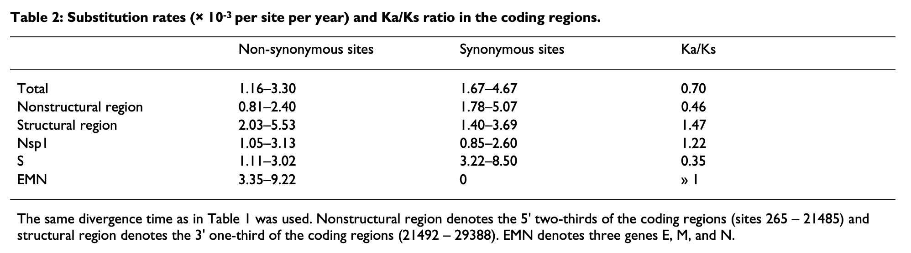
SARS evolutionary rate
Zhang et al., 2004, BMC Evol.

Slide 5

MERS evolutionary rate
Dudas et al., 2018, eLife

Slide 6
SARS-CoV-2 has an evolutionary rate similar to MERS-CoV-2
Duchene et al. (2019), Virus Evol. estimate the average rate to be 1.1 × 10⁻³ subs/site/year

Slide 7
Going wrong with the prior
NL63: 1.3 × 10−4 (CI 1.1 – 1.5 × 10−4)
229E: 2.5 × 10⁻⁴ (CI 2.2 – 2.7 × 10⁻⁴)
OC43: 2.1 × 10⁻⁴ (CI 1.9 – 2.3 × 10⁻⁴)
Müller et al., 2021, BioRxiv

Slide 8
Posterior is the product of Prior and Likelihood
Tree Prior describes how a tree was formed by a population model
Prior belief of what the parameters should be
Posterior probability
Tree likelihood
Du Plessis et al., 2015, Trends M.

Slide 9
Posterior is the product of Prior and Likelihood

Slide 10
How do the Prior and Likelihood act together

Slide 11
If the prior largely excludes the most likely values of the Likelihood

Slide 12
The so does the Posterior

Slide 13
If the Likelihood provides no information

Slide 14
Then the Posterior will be equal to the prior

Slide 15
If the prior is equal to the likelihood

Slide 16
Then the posterior will be more ”peaked/narrower” than either Prior or Likelihood

Slide 17
Everything affects everything.

Slide 18
True prior distributions are revealed by sampling under the prior.

